Slide 1
Year 6 SATs Parent Meeting
Monday 12th May – Thursday 15th May 2025

Slide 2
SATs Timetable
Date | Test
Monday 12 May 2025 | Grammar, Punctuation & Spelling - Paper 1 Grammar, Punctuation & Spelling Paper 2 Spelling
Tuesday 13 May 2025 | English Reading
Wednesday 14 May 2025 | Maths Paper 1 (Arithmetic) Maths Paper 2 (Reasoning)
Thursday 15 May 2025 | Maths Paper 3 (Reasoning)

Slide 3
GRAMMAR, PUNCTUATION & SPELLING
Expectations in the National Curriculum Tests

Slide 4
Grammar, Punctuation & Spelling
For Grammar, Punctuation and Spelling, there are two tests:
Short answers (50 questions in 45 minutes)
Spelling (20 words)

Slide 5
Grammar, Punctuation & Spelling
Short Answers Test
The short answers test is made up mostly of tick box, matching questions or one word answers.
Children are expected to know and use grammatical terminology accurately.
They are expected to use these skills in writing, but also within the Spelling, Punctuation and Grammar test.
There is a glossary available online: https://www.gov.uk/government/uploads/system/uploads/attachment_data/file/244216/English_Glossary.pdf

Slide 6
Grammar, Punctuation & Spelling
At QE, we are helping children with this by giving them grammar lessons each week, where we focus on key vocabulary and revise aspects that they would have learnt previously.
We sometimes give children this practice in the same format in which the tests are presented, so children are familiar with the style and layout.
As well as specific grammar activities, the teaching of grammar is also embedded into English lessons during the week.
Staff also give grammar intervention sessions and embed grammar within daily morning activities.

Slide 7
Grammar, Punctuation & Spelling
Spelling test
For the spelling test, the teacher reads out a sentence and the child fills in the gaps with the missing word.
For this, children are expected to apply their knowledge of spelling patterns for example, words ending in – cious, -sion, -ly. These patterns are the same patterns that children have for homework.
As well as the spelling patterns, the government have published a list of words which they expect children at junior school to learn. There is one for years 3 and 4, and one for years 5 and 6.

Slide 8
Grammar, Punctuation & Spelling

Slide 9
Grammar, Punctuation & Spelling

Slide 10
reading
Expectations in the National Curriculum Tests

Slide 11
Reading
The Reading test
The test consists of a reading booklet containing 3 texts and a separate answer booklet.
The test will last for 1 hour which includes reading time.
There will be a mixture of genres of text which may include fiction, non-fiction and poetry.

Slide 12
Reading – The SATs Test
The least-demanding text will come first with the following texts increasing in level of difficulty.
The questions will emphasise overall understanding/comprehension of the text.
Pupils can approach the test as they choose. However, we encourage and practise by reading the first question then reading the text to find the answer, answer the question then moving on.

Slide 13
Reading – The SATs Test
We are not able to read, explain or re-phrase anything for the children in this test, other than the general instructions to ensure that they understand these.
The questions are worth a total of 50 marks with some questions being awarded between 1 and 3 marks.

Slide 14
Question Types
The test will cover a range of reading skills, including:
Decoding words – understanding what words mean, using the context to help them.
Comprehension – summarise, retrieve, explain and sequence information from the text.
Inference – use the clues and what they know about situations to suggest likely outcomes/actions, including predicting, and explaining characters’ thoughts, actions and feelings.
Understanding the writer’s use of language to create an effect or impact the reader.
Themes and Conventions – why certain types of writing are like they are, themes or changes within a text.

Slide 15
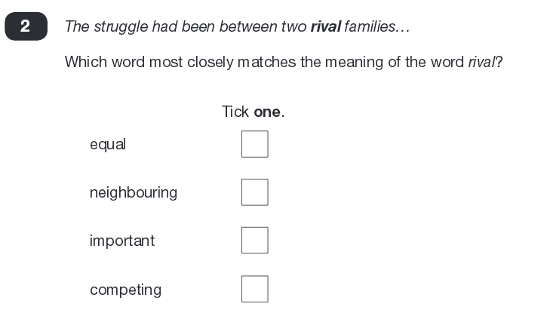
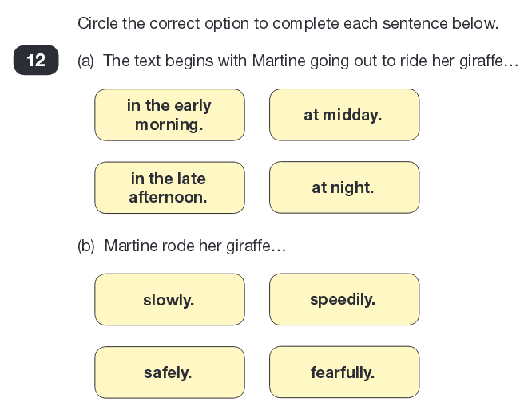
Reading – Question Examples Multiple Choice

Slide 16
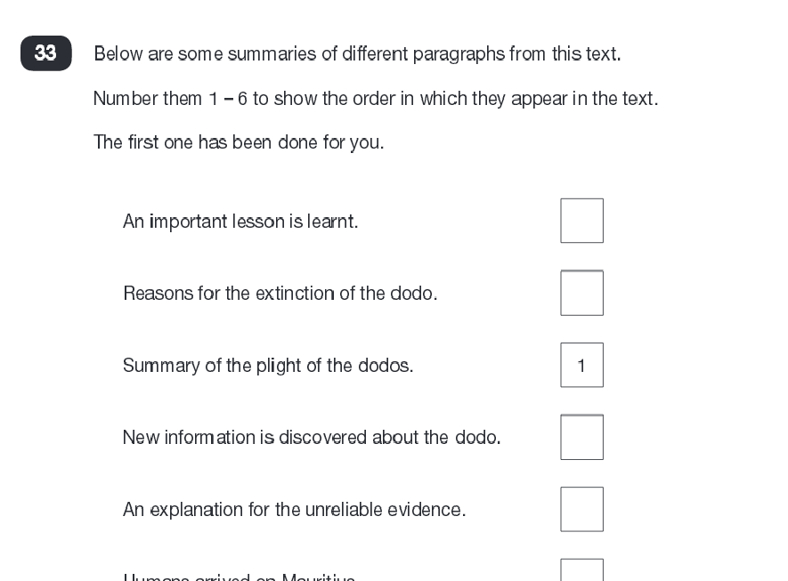
Reading – Question Examples Ranking or Ordering

Slide 17
Reading – Question Examples Matching

Slide 18
Reading – Question Examples Find and Copy

Slide 19
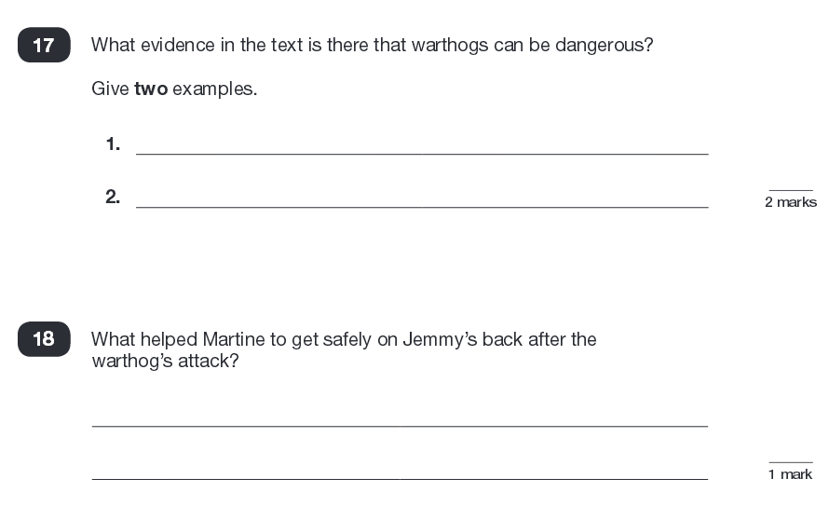
Reading – Question Examples Short Response

Slide 20
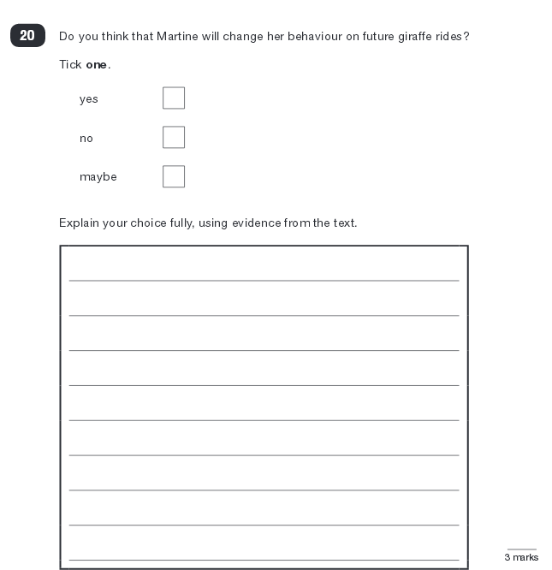
Reading – Question Examples Longer Response
These questions are worth the most marks
You are awarded marks for number of points or amount of evidence.
3 marks - 3 reasons or 2 with evidence from text.
2 marks – 2 reasons or 1 with evidence from text.
1 mark – 1 reason

Slide 21
P.E.E – Longer Answer Structure
POINT
Make the point
I think that…the character is angry
EVIDENCE
Provide the evidence
because the text says….that he shook with rage
EXPLAIN
Explain what it shows
and this shows that….he is struggling to control his temper after the argument.

Slide 22
Reading – Support at Home
What can parents do to help support their child?
Read a range of different texts e.g. poetry, newspaper, magazine articles as well as fiction books.
Develop focus and speed of reading in their heads by having quiet time reading.
Hear them read aloud a few times a week to ensure that they are taking account of punctuation (this will also support their awareness of and development in grammar and punctuation).
Note unfamiliar words and phrases and look these up together.

Slide 23
mathematics
Expectations in the National Curriculum Tests

Slide 24
Maths
Children will sit three papers in Maths:
Paper 1: arithmetic - 30 minutes
Papers 2 and 3: Mathematical fluency, solving problems and reasoning - 40 minutes per paper
Paper 1 will consist of fixed response questions, where children have to give the correct answer to calculations, including using formal written methods

Slide 25
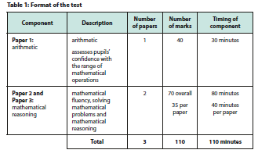
Maths
The format of the tests:

Slide 26
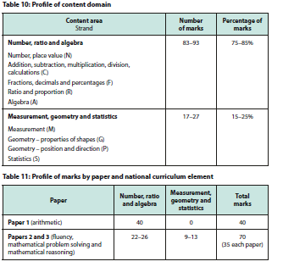
Maths
Marks awarded:

Slide 27
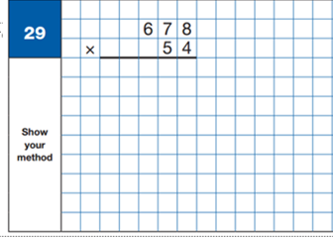
Maths Paper 1
Pupils will have 30 minutes to answer approximately 35 questions
Context free calculations
Majority of questions are worth one mark
Speed and accuracy are key

Slide 28
Maths
Papers 2 and 3 will involve a number of question types:
Multiple choice
Matching
True or false/yes or no
Fixed answer questions, e.g. giving the answer to a calculation, drawing a shape or completing a table or chart
Multiple answer questions, where children will have to explain their approach for solving a problem

Slide 29
Maths
Here is an example question

Slide 30
Maths
What can you do to help?
Quick mental facts- doubling and halving, adjusting for mental addition and subtraction. Learn all the time tables up to 12 x 12
Learn all the division facts up to 12 x 12
Practise formal methods of addition, subtraction, multiplication and division
Answer questions in their SATS practice books - these are similar to the reasoning paper.

Slide 31
RESULTS

Slide 32
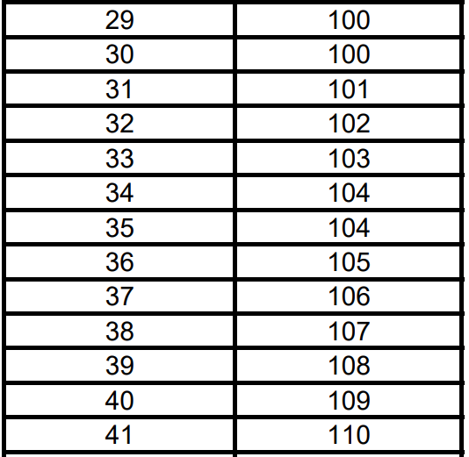
Results
Results will be released to schools in July.
As soon as the results have been processed by school, they will be sent home (this will be separate to the end of year reports).
You will receive the scaled score for each subject.
A scaled score of 100 is the ‘expected level’. 110 or over is greater depth.

Slide 33
Any questions?

