Slide 1
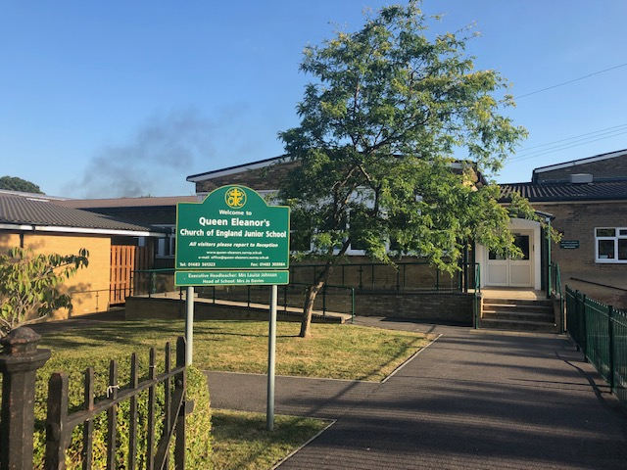
Year 4 Class Change
Welcome
Tuesday 14th May 2024

Slide 2
Rationale
When the children first started in Year 3, the information that was used to decide on classes came from a number of Infant Schools. Since Year 3, children have left the school and throughout the Year 3 and Year 4 academic years we have had new children joining the year group.
We need to consider the gender mix, learning abilities, children with specific needs and the personalities and dynamics within each class.
It is important to note that we are not making this change because of poor behaviour.
By mixing the classes up now it will mean that they will be in the best grouping for learning for the remainder of their time at Queen Eleanor’s. This will be monitored carefully and we will advise you if any further changes are necessary.
This change will support the children’s transition to Secondary School where they will not be with the same children/adults every lesson.
The children will have break, lunchtime and whole year group activity opportunities to socialise/work with children who were previously in their class.

Slide 3
Next Steps
The children will be asked to write down 3 friends they would like to remain in a class with. They will be told that they will definitely be with at least one of the friends. When? – this week
Current Year 6 children will speak to the Year 4 children as their classes were changed at the end of Year 4.
The Year 4 team (Class Teachers), Mrs Strickland (SENCO) and Senior Leader (Mrs Davies or Mr Papworth) will then decide on who goes in which class. When? – next week
The children will be told who they will be with. When? – first week back after May half term
The children will then be given opportunities, from when they are told until the end of the summer term, to spend time in their new classes. Each current Year 4 staff member will have the opportunity to be with each new class and will feedback how the new groups are working together. They will spend the day in their new classes on the Transition day (Tuesday 2nd July 2024).
Rocio Barnes, Home School Link Worker and Mrs Strickland, SENCO, will be available to support children with the change should they benefit from this.

Slide 4
What do the children say?
I completed a Pupil Voice activity with our current Year 6 children, who experienced a class change when they moved from Year 4 to Year 5. They said the following…
Helped with friendship issues – has prevented any disagreements coming into the classroom and impacting learning time.
Given us the opportunity to get to know everyone.
I have gained a new friendship group.
The change has prepared me for Secondary school.
I was new to the school in Year 4 so this helped me to meet new people.
I found it initially challenging but I have made so many more friends.
My friendship group has expanded.
Still have the opportunity to socialise with those who used to be in my class.

Slide 5
Thank you
Any Questions?

